Slide 1
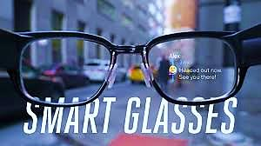
SMART GLASSES
A Project By Kajal Bhalghare And Rutuja Bhoi

Slide 2
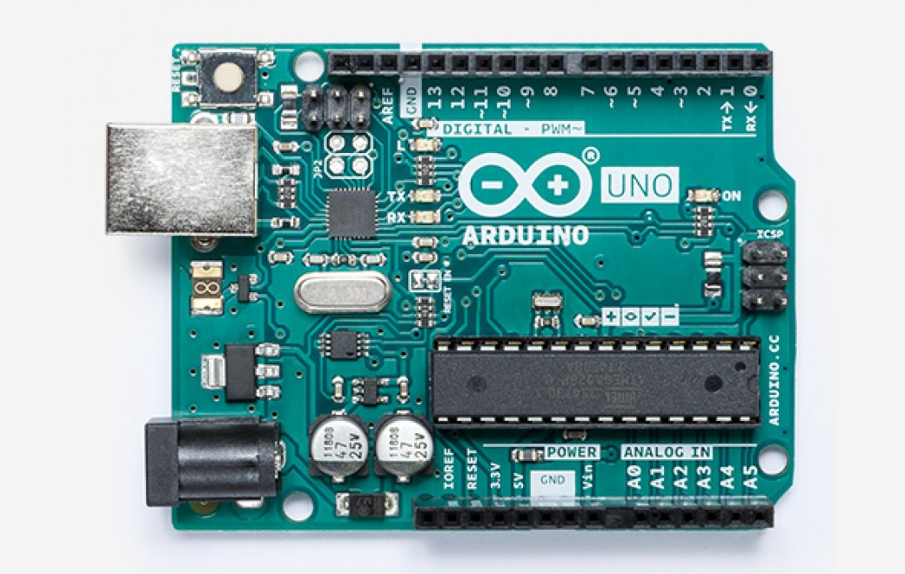
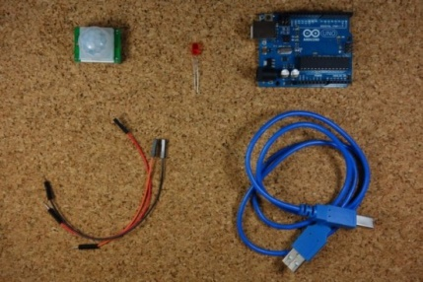
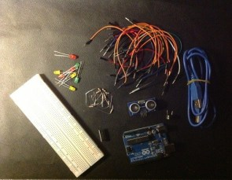
Parts Needed
Arduino UNO
Jumper Wires
Power Supply
Sensors
Ultrasonic Sensor(HC-SR04)
Infrared Sensor(HC-SR04)

Slide 3
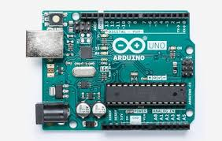
Arduino uno
Arduino is mainly a microcontroller circuit mainly used for hardware oriented projects.
Ps:It is cheaper than raspberry pi (mini computer or motherboard)

Slide 4
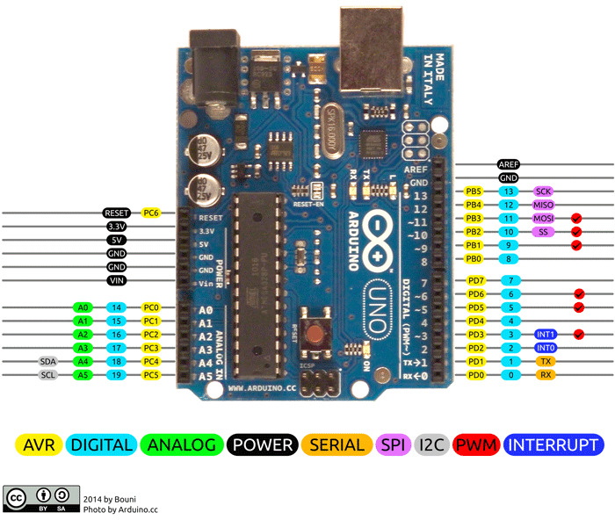
Pin diagram

Slide 5
Arduino.cc or arduino.org?
arduino.org
Origin(Massimo Banzi & partners)
arduino.cc
smart projects company(by partners)
Arduino.org
(Massimo Banzi)
Points to remember:
Arduino.org and arduino.cc share the same logo
Arduino.org owns trademark in US as Arduino and Genuino in other countries and it’s boards are assembled by some other manufacturing companies.
Arduino.org redirects its site to arduino.cc.
Arduino.org owns trademark in US as well as in other countries as Arduino and majority of it’s boards are assembled by Smart Projects company as SRL for Arduino LLC.

Slide 6
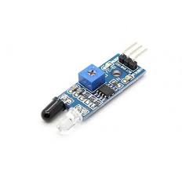
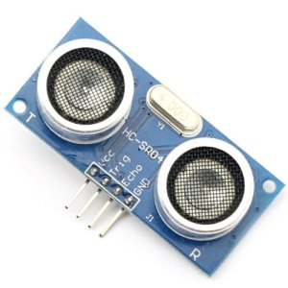
Sensor Specifications
IR Proximity Sensor
UV Sensor

Slide 7
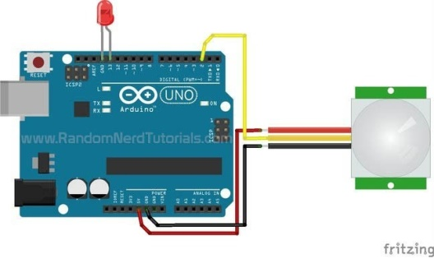
IR Sensor
It can detect motion based on changes in infrared light in the environment. It is ideal to detect if a human has moved in or out of the sensor range.

Slide 8
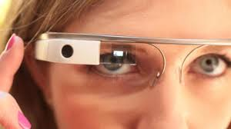
Our application of ir sensor in smart glasses:
The IR proximity sensor detects even small movements and obstacles within short range. Hence it can also detect blinking of eyelids.
As a real time application if this sensor is fitted alongside the rim of the glasses intact with the eyes of a motorcycle driver, it detects the movement of the batting of eyelids. If the driver falls asleep the time delay in lid movement gets detected by the sensor and in such case the buzzer and led is turned on by the relay circuit to wake up the sleeping driver.

Slide 9
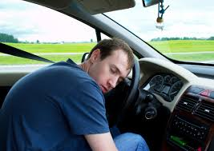
Sleepiness can impair driving performance as much or more so than alcohol, studies show.

Slide 10
The Drowsy Driving Problem
Drowsiness—
Makes drivers less able to pay attention to the road.
Slows reaction time if you have to brake or steer suddenly.
Affects a driver’s ability to make good decisions.

Slide 11
Who’s more likely to drive drowsy?
Drivers who do not get enough sleep.
Commercial drivers who operate vehicles such as tow trucks, tractor trailers, and buses.
Shift workers (work the night shift or long shifts).
Drivers with untreated sleep disorders such as one where breathing repeatedly stops and starts (sleep apnea).
Drivers who use medications that make them sleepy.
Sensor Specifications

Slide 12
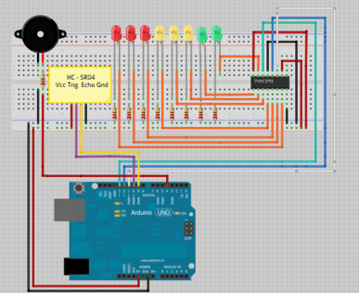
UV Sensor
It measures the distance and the LED’s bar graph will light up according to our distance from the sensor and as we get closer the buzzer beeps in a different way.
PS: The breadboard displayed in the following diagram is only used for testing purposes it is NOT the part of run time circuit.

Slide 13
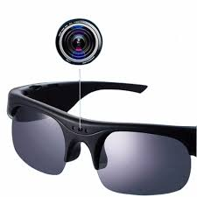
Our application of UV sensor in smart glasses:
The UV sensor used is ranged 4m wide(This range can be altered by the arduino code). Any object approaching within this range is detected by the UV sensor and activates the buzzer connected to its relay circuit.
As a real time application if this sensor is fitted in front top of the glasses it senses the incoming object like a speedy vehicle which has invaded the specified range of the sensor and the driver gets a warning in time to handle this situation. Thus an accident can be prevented beforehand.
Drivers can wear these glasses as a safety measure to avoid crashes.
Sensor Specifications

Slide 14
ArduinoCode:
FINALCODE\final combine code\IRandUVcode.ino

Slide 15
IEEe on road safety
Road safety is an important consideration in the transportation system. Many accidents occur due to road safety problems. Road accidents in India are increasing day by day, due to the rapid growth in a number of vehicles. The traffic congestion is growing at a rate of 7 to 10 % per annum while the vehicles are 12% per annum, hence this is one of the primary factors for the road safety problem. Every year nearly 1 million people died and 50 million are injured due to road accidents around the world. Particularly in India, 70,000 people died every year, this problem needs to overcome to save the life of the people. In this paper, a survey is done based on the various road safety problems and the comparison is done to identify the problem which leads to major accidents. Here the idea is proposed based on the statistics of the road safety issues to reduce the number of accidents that occur in a year.
Published in: 2018 IEEE International Conference on Computational Intelligence and Computing Research (ICCIC)

Slide 16
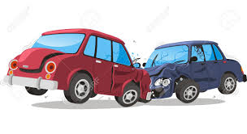
Ieee standard for minimum distance between two vehicles
The Road Code states that all drivers must keep a safe distance between their vehicles and the vehicle in front, so that they can stop at the right time and avoid collision. Outside urban areas, when overtaking is forbidden for some categories of vehicles, between such vehicles a distance of at least 100 m is required.

Slide 17
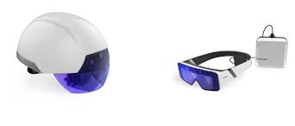
Advantages of this project
Easy and cheap
Implemented for road safety purposes therefore can prevent on road accidents.

Slide 18
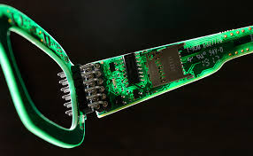
Limitations of arduino uno we came across
Not compact
Shortage of ground pins
Low RAM capacity of about 32256 bytes(not suitable for lenghty codes)
Ps:Our project acquires 3194bytes on Arduino RAM

Slide 19
modifications we wish to make furthermore in this project
Make this project more compact.
Install gps and bluetooth speaker for location and calling purposes
Install wifi connectivity by working on arduino furthermore
Interfacing python with arduino.(currently working on it)
Build an app for controlling the device.

Slide 20
A special thanks to S.B.Mule sir for guiding us throughout this project

Slide 21
Project Resources
..\..\Downloads\Arduino - Home_files
Site Address: www.arduino.cc
..\..\Downloads\Arduino - Ultrasonic Sensor with LED's and buzzer _ Random Nerd Tutorials_files
Site Address: https://randomnerdtutorials.com/arduino-ultrasonic-sensor-with-leds-and-buzzer/
..\..\Downloads\Arduino with PIR Motion Sensor _ Random Nerd Tutorials_files
Site Addess: https://randomnerdtutorials.com/arduino-with-pir-motion-sensor/

